Slide 1


Unit-2: Migrating into cloud
Here starts the lesson!

Slide 2
Contents
Broad Approaches to Migrating into the Cloud
The Seven-Step Model of Migration into a Cloud VM Migration
Cloud Middleware and Best Practices
Concept and Need of Cloud Middleware
QoS Issues in Cloud
Data Migration and Streaming in Cloud
Interoperability

Slide 3
Approaches to migrating
It refers to the movement or transfer between different physical machines without any discontinuity.
What challenges and obstacles clients might have to overcome to tap into the cloud?
How their management of IT must change to secure and control their new cloud-driven infrastructure?
When you migrate from a client to the cloud, the issues you will face fall into the following overall categories.

Slide 4
Security
Vendor Management
Security
Security is an obvious threshold question, if the cloud is not secure, enterprises will not consider migrating to it fearing their sensitive data will be tampered.
It includes activities such as selecting vendors, negotiating contracts, controlling costs, reducing vendor- related risks and ensure service delivery.

Slide 5
Technical Integration
The Business View
Most firms that migrate to the cloud environment
in a hybrid model, are keeping certain key elements of their infrastructure in-house and under
their direct control, while outsourcing less susceptible or core components. Integrating internal
and external infrastructures can be a technical concern.
When the user is going to migrate with the outsource providers, then the service level agreements and its terms are thoroughly checked. While the whole idea behind cloud computing is to
propose a standardized, multi-tenant infrastructure, cloud vendors may not offer the same level
of custom SLAs as IT managers

Slide 6

While implementing a cloud, migration expected at replacing on a premise major business application may look like, at times, a simple straightforward implementation. It is burdened with pit
falls, which may undermine the true value to the investment, and in fact put enterprises in bad
situation than before.

Slide 7
Understanding and planning for these pitfalls is significant for a successful
deployment of the solution.
IT and business stakeholders must work
together and have to:
● Clearly state business objectives for the cloud migration.
● Define project scope of the cloud migration.
● Provide a set of guiding principles for all to follow.

Slide 8

Seven step migration model
Steps to perform suitable migration

Slide 9
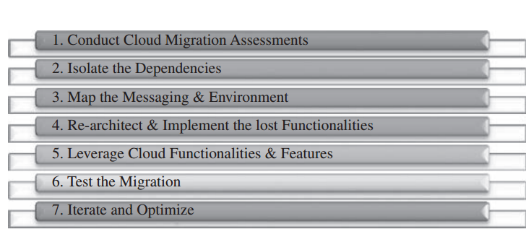

Slide 10

Step 1
These assessments are about the cost of migration as well as about the ROI that can be achieved in the case of production version.
Assessment level:-Cloud migration assessments comprise assessments to understand the issues involved in the specific case of migration at the application level or the code, the design, the architecture, or usage levels.

Slide 11
Step 2
Step 3
Isolate: Isolating all systemic and environmental dependencies of the enterprise application components within the captive data center .
Mapping : Generating the mapping constructs between what shall possibly remain in the local captive data center and what goes onto the cloud.

Slide 12
Step 4
Step 5
Re-architected : substantial part of the enterprise application needs to be rearchitected, redesigned, and reimplemented on the cloud.
Augument: We leverage the intrinsic features of the cloud computing service to augment our enterprise application in its own small ways.

Slide 13
Step 6
Step 7
Validate: we validate and test the new form of the enterprise application with an extensive test suite that comprises testing the components of the enterprise application on the cloud as well
Optimization :Test results could be positive or mixed.
In the latter case, we iterate and optimize as appropriate. After several such optimizing iterations, the migration is deemed successful

Slide 14
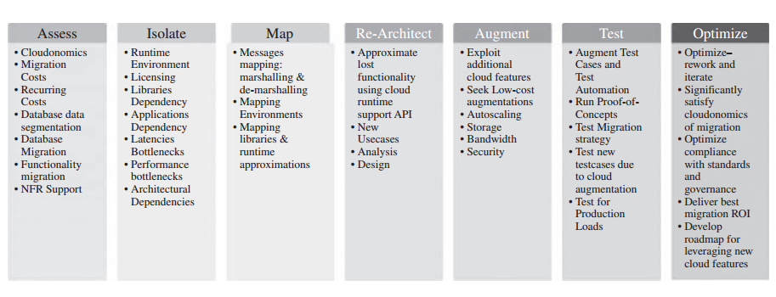
Process

Slide 15
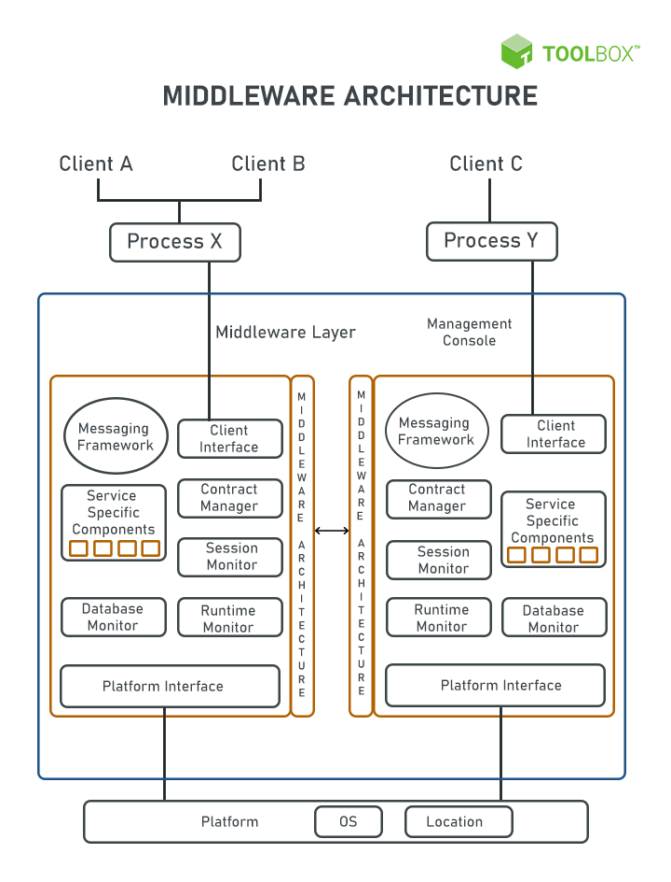

Cloud middleware
Another way to define middleware is to say that it is software that acts as a liaison between applications and networks. The term is often used in the context of cloud computing, such as public or private cloud.

Slide 16
Definition of Concepts
It is adopted by organizations trying to decouple all their business units, depending on integration and reusability for daily operations. SOA allows organizations to use existing application and system investments.
Each of these components must be able to interact with one another and other parts of the system. Apart from some basic components, each type of middleware needs a specific component. For example, a database middleware needs a database manager component.
Most middleware follows the service-oriented architecture (SOA) design or is designed as a platform-as-a-service (PaaS) solution. SOA is an architectural style that tries to achieve loosely coupled software applications that interact among themselves to run as a whole.

Slide 17
Components in middleware
Common messaging framework
Middleware requires messaging services to communicate with services, applications, and platforms. Most of these frameworks rely on existing standards such as simple object access protocol (SOAP), representational state transfer (REST), or Javascript object notation (JSON).
Middleware management console
This console provides an overview of events and activities, transactions, configuration management, and contract rules.
Platform interface
Middleware needs to work across multiple platforms, irrespective of where it resides. This is the interface that is in direct contact with the backend servers.

Slide 18


Need of cloud middleware

Slide 19
Secure connections and data transfer
Configure and control connections and integrations
Middleware typically establishes a secure connection from the front-end application to back-end data sources using Transport Layer Security (TSL) or another network security protocol. And it can provide authentication capabilities, challenging front-end application requests for credentials (username and password) or digital certificates.
Based on information in a client or front-end application request, middleware can customize the response from the back-end application or service. In a retailer's ecommerce application, middleware application logic can sort product search results from a back-end inventory database by nearest store location, based on the IP address or location information in the HTTP request header.

Slide 20
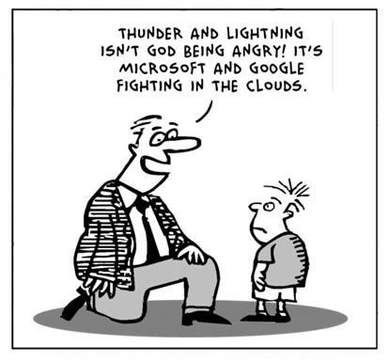
Manage traffic dynamically across distributed systems
When application traffic spikes, enterprise middleware can scale to distribute client requests across multiple servers, on premises or in the cloud. And concurrent processing capabilities can prevent problems when multiple clients try to access the same back-end data source simultaneously.

Slide 21
Quality of service- issues in Cloud
It is a challenge to
implement QoS in cloud computing applications. There are
many techniques to provide quality of service to the cloud
applications. Scheduling, admission control and dynamic
resource provisioning are some techniques used to achieve
that goal.
Quality of Service refers to the ability of networks to attain
maximum bandwidth and handle other network elements
like latency, error rate and uptime. Quality of Service
include the management of other networks resource by
allocating priorities to specific type of data (audio, video
and file).

Slide 22
Challenges
Scheduling:
Cloud service scheduling categorized into two categories:
user level and system level. At user level scheduling deals with problems raised by service providing between both service provider and customer. Market based and auction based schedulers are fit for ruling the supply and demand of cloud resources. Market based resource allocation is powerful in cloud computing environment where resources are handed over to user as a service. The system level scheduling handles with resource management in datacenter. Datacenter contain many physical machines, Million request sent from user’s side, scheduling these requests to the physical machines done in datacenter. This scheduling affect the performance of datacenter. Service provisioning in cloud systems based on Service Level Agreement (SLA). SLA is the contract between service provider and customer mentioning the terms of agreement
including the nonfunctional requirement represented as QoS.

Slide 23
Challenges
Admission Control: The main purpose of admission control is to provide strong performance. At admission control time, the Infrastructure Provider (IP) must consider the extra requirement along with the fundamental computational and networking necessities that may be required to be added to runtime so it become flexible. In many cases, these flexible requirements may be very large comparing it to the normal requirements. For example, if there are many users are working on cloud application with high divergence, the number of virtual machines are required more and that may be added at runtime many times multiple of the number of the basic ones. So that, the number of flexible requirements plays important role in the total requirements and therefore the cost of hosting the service

Slide 24
Challenges
Resource provisioning:
Dynamic resource provisioning is the process of assigning
available resources to the cloud application. Resource
allocation will make services suffer if the allocation not
managed in the right way. Resource provisioning will solve
this problem by allowing the service providers to manage
the resources of modules individually. Resource Allocation
Strategy (RAS) is all about integrating service provider
services activities to allocate insufficient resources within
the limit of cloud environment so that it meets the needs of
the cloud application. It need the demand and type of
resources for each application to complete the user task.
The order and allocation time for resources are inputs for
optimal RAS.

Slide 25
Data migration
Data migration is the process of transferring data from one storage system or computing environment to another. There are many reasons your enterprise might need to undertake a data migration project. For example, you might be replacing servers or storage devices or consolidating or decommissioning data center. Data migration is also an essential step in the overall process of migrating on-premises IT infrastructure to a cloud computing environment. Whether you’re moving to a public cloud, private cloud, hybrid cloud, or multicloud environment, you’ll need to find a secure, cost-effective, and efficient method of migrating your data to its new storage location.
You can choose among several options for transferring data from a local data center to the cloud, but broadly speaking, they fall into two categories:
Online migration, in which data moves across the Internet or a private or dedicated WAN connection.
Offline migration, in which data is transferred via a storage appliance that’s physically shipped between its data center of origin and the target cloud storage location.
The best option for your specific data migration project depends upon how much data you need to move, how quickly the migration must be accomplished, the types of workloads involved, and your security requirements.

Slide 26
Data Streaming
Streaming data is data that is generated continuously by thousands of data sources, which typically send in the data records simultaneously, and in small sizes (order of Kilobytes). Streaming data includes a wide variety of data such as log files generated by customers using your mobile or web applications, ecommerce purchases, in-game player activity, information from social networks, financial trading floors, or geospatial services, and telemetry from connected devices or instrumentation in data centers.
This data needs to be processed sequentially and incrementally on a record-by-record basis or over sliding time windows, and used for a wide variety of analytics including correlations, aggregations, filtering, and sampling. Information derived from such analysis gives companies visibility into many aspects of their business and customer activity such as –service usage (for metering/billing), server activity, website clicks, and geo-location of devices, people, and physical goods –and enables them to respond promptly to emerging situations. For example, businesses can track changes in public sentiment on their brands and products by continuously analyzing social media streams, and respond in a timely fashion as the necessity arises.

Slide 27
Cloud Interoperability
There is a strong need for the development of integrated interoperability authentication among all provider
Cloud interoperability. This term refers to the ability of two or more systems or applications to exchange information and to use the information that has been exchanged together.

Slide 28
Standards
Platform Portability: It means application development environment or IDE should be capable enough to run over any type of cloud infrastructure.
Infrastructure Portability: It means virtual server or machine images should have the freedom of portability. They should be able to migrate from one cloud provider to another.
When consumer wishes to migrate from one cloud Provider to another, interoperability falls into these categories:
Data and Application Portability: It means by running applications and data, consumers should be able to migrate easily from one cloud provider to another without any lock-in issue.

